Slide 1

GROUP 9 Arush Rao Rohit Yadav Moneel Kothare Jenny Jiang
MUSIC POPULARITY PREDICTION

Slide 2


Spotify has become one of the top streaming providers in the Music industry. It has become considerably difficult for the management to decide what record labels and artists should be offered a contract and the kind of music or artists that should be promoted via paid advertisements and whether their music should be part of their free or premium service. The goal of this project was to predict whether a song is popular or not based on the song attributes(Metadata) and genre that Spotify provides. We ran an analysis on about approximately 6000 hit and non-hit songs to help understand what makes a song popular and if we could predict whether it will be on the Top 100 Billboard or not. After exploring Machine Learning and Data mining algorithms throughout this course, we chose to run Logistic Regression, K-Nearest Neighbors, Support Vector Machine, Decision Tree algorithms on our data set. We found that Logistic Regression yielded the highest accuracy of 80.54% on the validation set in predicting whether a song will be on the Top 100 billboard or not.
Summary

Slide 3
Scenario
It is difficult for companies in the music industry to decide what artists/labels they should sign on and what kind of music they should onboard to the platform. We aim to help in contributing to the decision-making process by finding patterns in the music data over the last decade.

Slide 4
Objectives/Decisions
Does Genre matter?
What features(metadata) contribute to a song being popular?
Could we really predict the popularity of a song based on its attributes provided by Spotify?

Slide 5
Dataset
The dataset we chose was obtained from Spotify’s API. This dataset initially consisted of 6398 records spread across 19 variables. The dataset represents a mix of tracks over the last decade. They are classified as ‘Top 100’ based on whether they were, at any point of time, during the last decade at any position in the ‘Top 100’ weekly charts. This means that even if the track was at Number 100 for a week, it will be classified as a ‘Top 100’ track. However, to have an accurate model, we need to reduce the number of predictors(variables) based on what impact they have on our outcome variable. Since our goal is to predict the popularity of a song, we choose the variable ‘Top 100’ as the outcome variable.
We eliminate the variables ‘uri’, and ‘sections’ as these are particular to Spotify and are links to access these tracks. Also, the initial few renders of our models showed that the ‘time_signature’ does not really influence the model in any way as it is relatively constant for all the tracks. Hence, we also eliminate the ‘time_signature’ variable. They do not in any way impact the data and will not be necessary for our analysis.
For ease of understanding and usability, we make a few changes to the data structure of certain variables. We convert the ‘duration_ms’ (duration in milliseconds) to seconds since it is easier to interpret. We also change the data structure of the ‘Top 100’ variable from integer to factor since it is the outcome variable and the classifier.

Slide 6

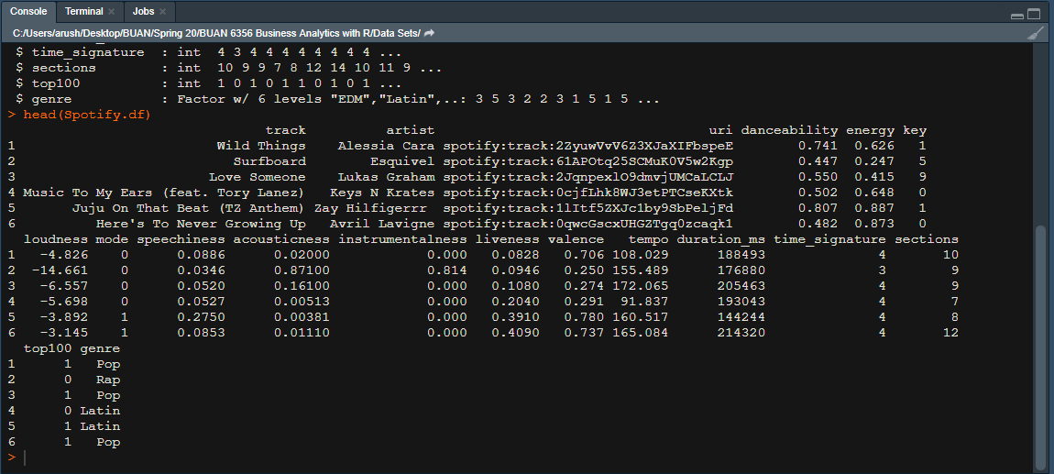




Slide 7
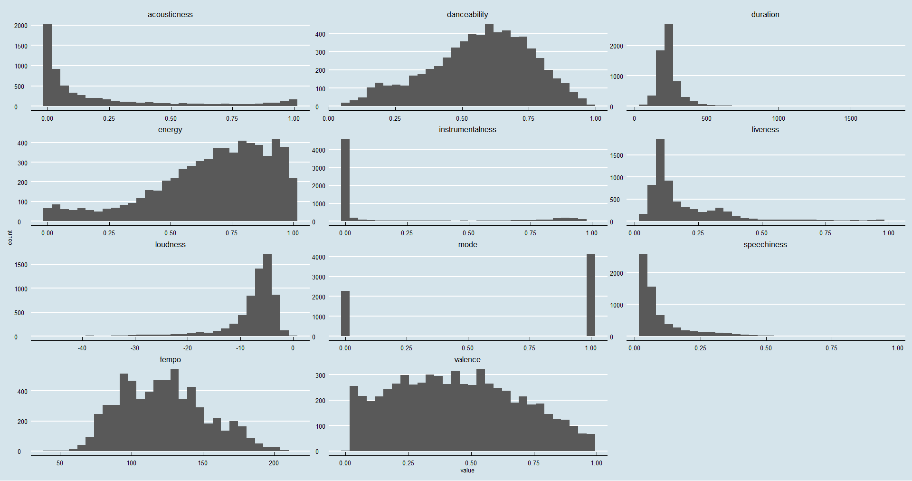
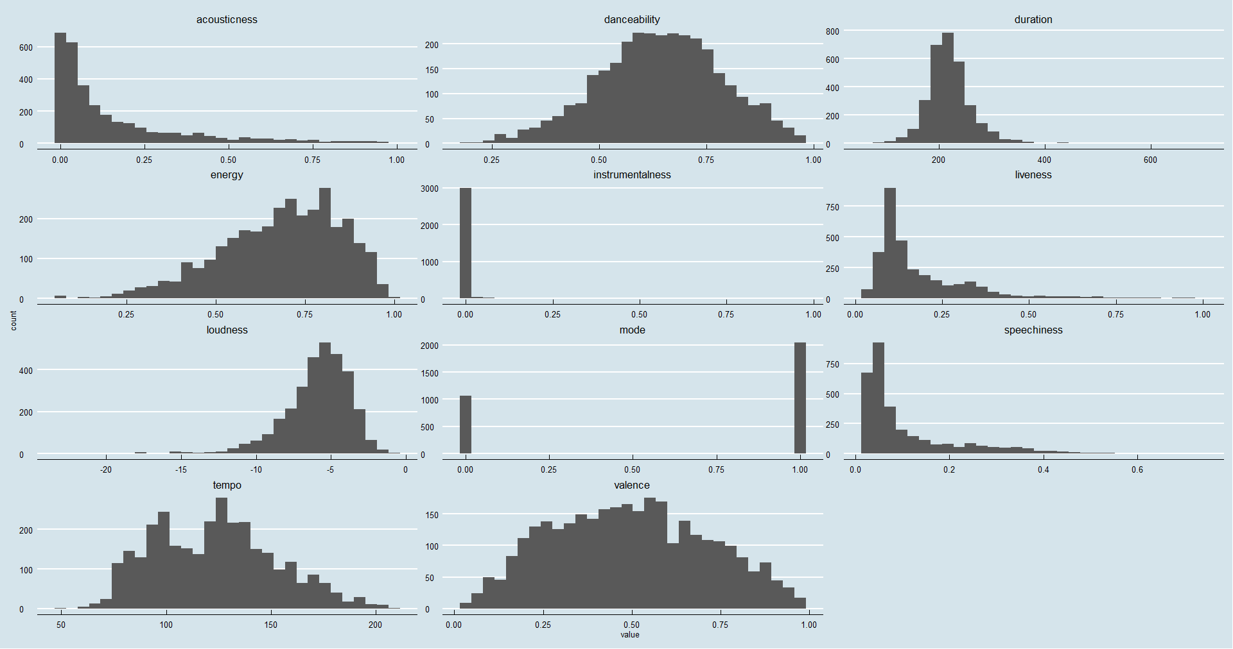
FUN FACTS AND VISUALIZATIONS
Distribution of Features across all songs
Distribution of Features across Hits

Slide 8
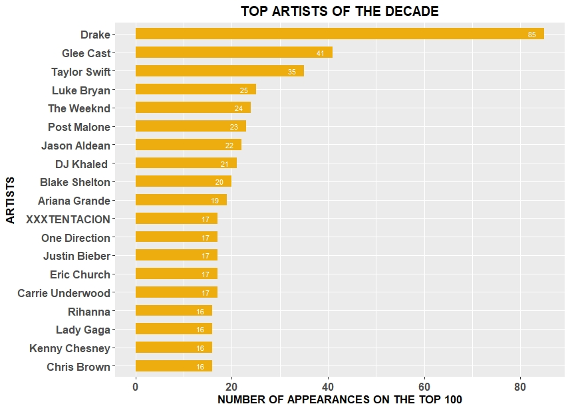

Slide 9
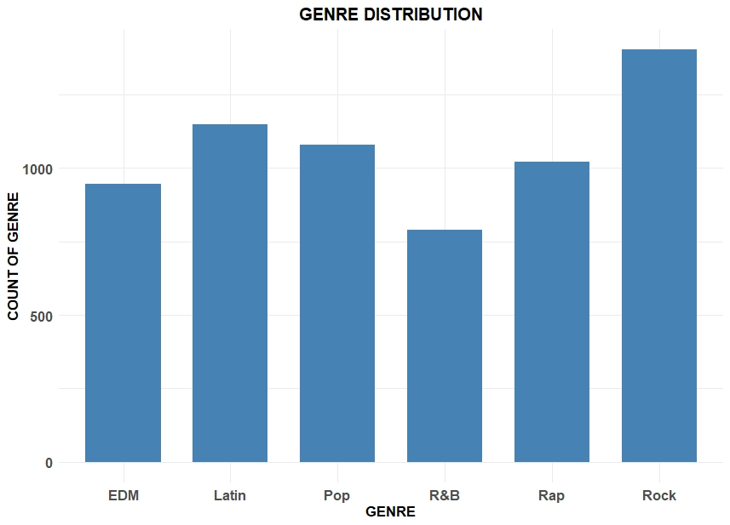
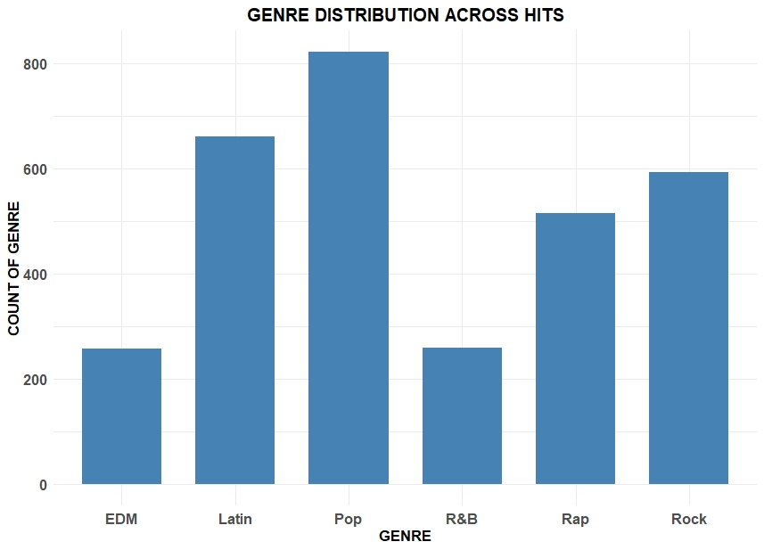
DISTRIBUTION OF GENRE
GENRE DISTRIBUTION - OVERALL
GENRE DISTRIBUTION - HITS

Slide 10
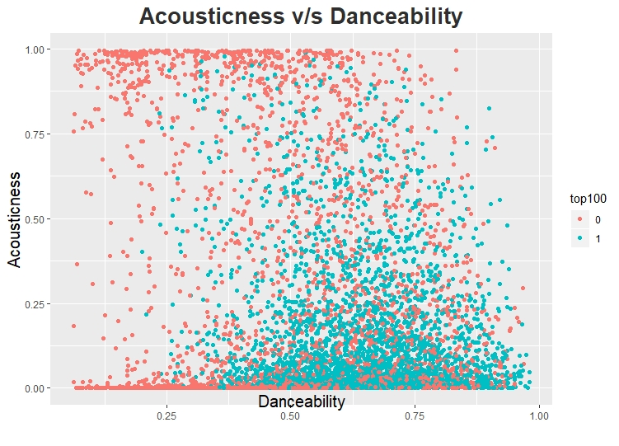

Slide 11
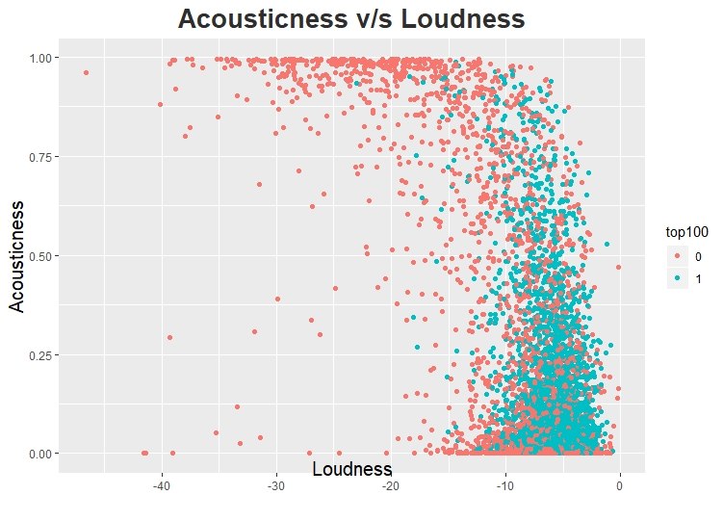

Slide 12

SUMMARY OF FACTS AND VISUALIZATIONS
Majority of the songs are not acoustic and are not recorded live.
Drake is the top artist of the decade.
Although ROCK is the genre with the most records in our dataset, POP is the top genre when it comes to Billboard Success.
Hit Songs have high danceability and low acousticness.
Hit Songs also have high loudness.

Slide 13
Models Implemented
Logistic Regression
K- Nearest Neighbors (KNN)
Support Vector Machine (SVM)
Decision Tree

Slide 14
Logistic Regression
Why this?
One of the basic and popular algorithms.
Is used when we aim for classification or when the output is categorical.
How ?
Underlying technique is quite same as Linear Regression.
Logistic because of “Logit function” used for classification.
R-code:
Used glm function to implement this algorithm.
classifier <- glm(formula = top100 ~ .,
family = binomial,
data = training_set)

Slide 15
K-Nearest Neighbors (KNN)
Why this?
Supervised Machine Learning Algorithm.
Used for both classification and regression problems.
Simplicity and lack of parametric assumptions
How?
The idea in k-nearest-neighbors methods is to identify k records in the training dataset that are similar to a new record that we wish to classify. We then use these similar (neighboring) records to classify the new record into a class, assigning the new record to the predominant class among these neighbors.
R-code:
y_pred_training_knn <- knn(train = training_set[, -11],
test = training_set[, -11],
cl = training_set[, 11],
k = 66)

Slide 16
Support Vector Machine (SVM)
Why this?
Powerful for both regression and classification Tasks.
More Commonly used for classification purposes, thus use here as well.
How?
Based on the idea of finding a hyperplane that best divides a dataset into two classes. (In depth working explained in further slides)
R-code:
classifier <- svm(formula = top100 ~ .,
data = training_set,
type = 'C-classification',
kernel = 'linear')

Slide 17
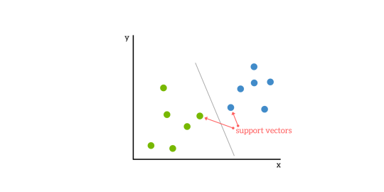
How SVM works?
SVMs are based on the idea of finding a hyperplane that best divides a dataset into two classes.
Support vectors are the data points nearest to the hyperplane. They can be considered the critical elements of a data set.

Slide 18
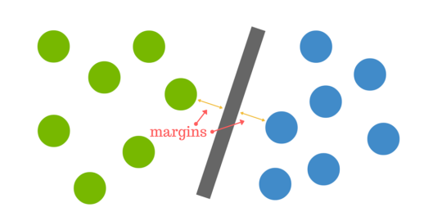
HyperPlane
What is it?
A line that linearly separates and classifies a set of data.
We want our data points to be as far away from the hyperplane as possible, while still being on the correct side of it.
when new testing data is added, whatever side of the hyperplane it lands will decide the class that we assign to it.
How to find it?
Distance between the hyperplane and the nearest data point from either set is known as the margin.
Goal is to chose a hyperplane with the greatest possible margin between the hyperplane and any point

Slide 19

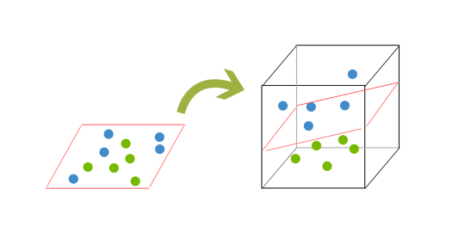
What happens when there is no clear hyperplane?
In order to classify a dataset like the one above, it is necessary to move away from a 2d view of the data to a 3d view. Explaining this is easiest with another simplified example. Imagine that our two sets of colored balls above are sitting on a sheet and this sheet is lifted suddenly, launching the balls into the air. While the balls are up in the air, you use the sheet to separate them. This ‘lifting’ of the balls represents the mapping of data into a higher dimension. This is known as kernelling.
Because we are now in three dimensions, our hyperplane can no longer be a line. It must now be a plane as shown in the example above. The idea is that the data will continue to be mapped into higher and higher dimensions until a hyperplane can be formed to segregate it.

Slide 20
Decision Tree
Why this?
Decision trees are also a popular classification method.
They train decision trees on different attributes of a dataset and help us in understanding and reducing the variance.
provide easily understandable classification rules (at least if the trees are not too large).
How?
Uses bagging and feature randomness when building each individual tree to try to create an uncorrelated forest of trees whose prediction by committee is more accurate than that of any individual tree.
R-code:
Used rpart library
classifier <- rpart(formula = top100 ~ .,
data = training_set,
control = rpart.control(minbucket = 50, maxdepth = 5, cp = 0.0001))

Slide 21
PREDICTIVE MODELS - ACCURACY
MODEL | ACCURACY
 | Training Data | Validation Data
Logistic Regression | 79.3% | 80.54%
KNN | 76.95% | 77.52%
SVM | 78.74% | 79.81%
Decision Tree | 80.48% | 80.02%

Slide 22
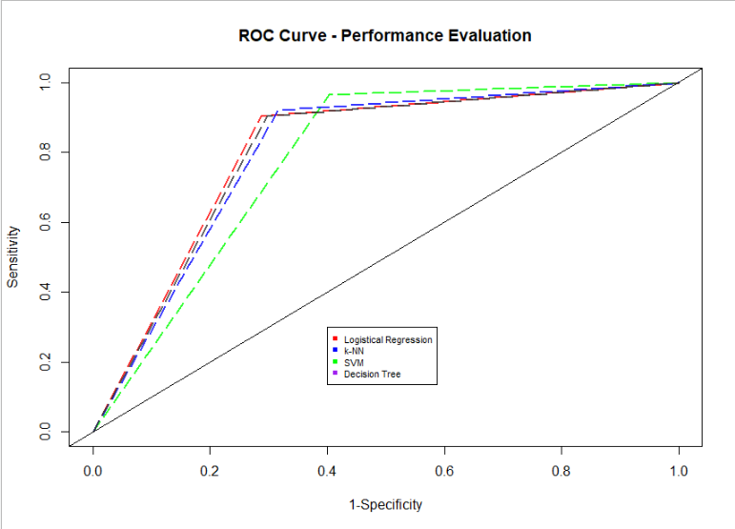
ROC CURVE COMPARISON

Slide 23

OUTCOMES
We consider Logistic Regression as our best model with an accuracy of 80.54% indicating that our model will be able to predict the probability whether a song will be popular or not, ≈ 81% of the time.
The analysis and model built here focuses on both, the audio industry as well as the listeners/end users. Audio labels/ talent acquisition agencies can use this data to decide whether they should be interested in signing an artist. Artists can use this as a reference while creating content to decide what attributes their tracks must include to be a Billboard success.

Slide 24
LIMITATIONS
It considers a single artist representing every track, ruling out the possibility of collaborations between artists influencing song popularity.
This model depends on the audio features provided by Spotify which is a unique feature exclusive to them. It is not an industry standard hence the analysis will be limited to data provided by Spotify.
It does not consider external factors such as current environment, artist popularity, rhymes, current trends, advertisements etc. which are very influential to the popularity of a song.

Slide 25
FUTURE WORK
We would like to have more attributes about the songs so that we can provide better results for the task of predicting popularity.
A few attributes about external factors influencing popularity would be helpful. For example: knowing the advertising rate of amount spent at advertising etc.
User data such as the number of streams, age group etc. would help us make more accurate and specific predictions
We would also like to implement Neural Networks and deep learning techniques to understand if we can classify the songs better.

Slide 26

THANK YOU FOR YOUR TIME!

